Slide 1
DFA Project
Theoretical Foundations – Spring 2019
Jenna Lovett

Slide 2
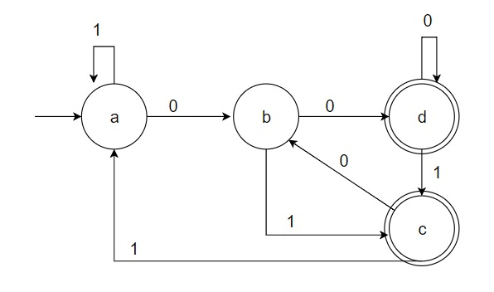
(0 U 1)* (00 U 01)

Slide 3
Input File
{0,1}
{a,b,c,d}
a
{c,d}
(a,0)->b
(a,1)->a
(b,0)->d
(b,1)->c
(c,0)->b
(c,1)->a
(d,0)->d
(d,1)->c

Slide 4
Tidbits
All input was received as Strings and kept as Strings
ArrayLists were used to store all input, except the start state
HashMaps were used to map states/alphabet elements to row/column indices
2D Matrix was used to hold transition function

Slide 5
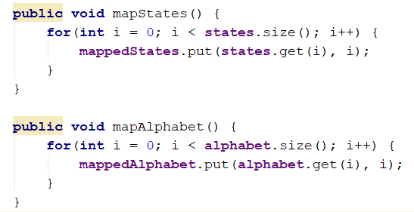

Slide 6
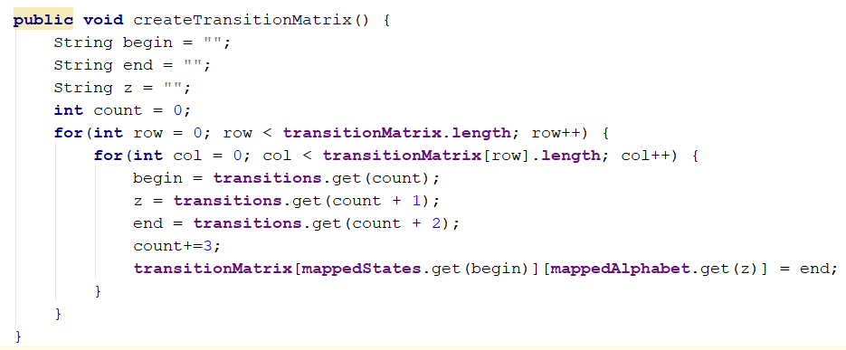

Slide 7
GitHub Repository
https://github.com/JennaLovett/dfa

